Slide 1

OOPM-IA-2
TOPIC:
LIBRARY
MANAGMENT
SYSTEM
AAKRITI MEHTA - 16010122109
KHUSHI MENPARA - 16010122118

Slide 2
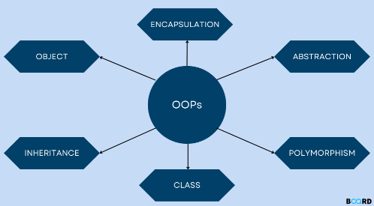
CLASS DIAGRAM
WHAT IS CLASS DIAGRAM ????
The class diagram is the main building block of object-oriented modeling. It is used for general conceptual modeling of the structure of the application, and for detailed modeling, translating the models into programming code. Class diagrams can also be used for data modeling.

Slide 3
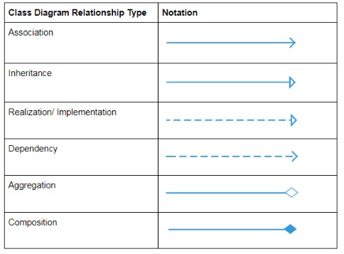
Association:
An association class is a class that is part of an association relationship between two other classes. You can attach an association class to an association relationship to provide additional information about the relationship.
Inheritance:
The process of a child or sub-class taking on the functionality of a parent or superclass, also known as generalization. It's symbolized with a straight connected line with a closed arrowhead pointing towards the superclass.
Realization:
A realization is a relationship between classes, interfaces, components and packages that connects a client element with a supplier element.
Dependency:
An object of one class might use an object of another class in the code of a method. If the object is not stored in any field, then this is modeled as a dependency relationship.
Aggregation:
Aggregation can occur when a class is a collection or container of other classes, but the contained classes do not have a strong lifecycle dependency on the container.
Composition:
It's a composition if one parent class object owns another child class object and that child class object cannot meaningfully exist without the parent class object. If it can then it is called Aggregation.

Slide 4
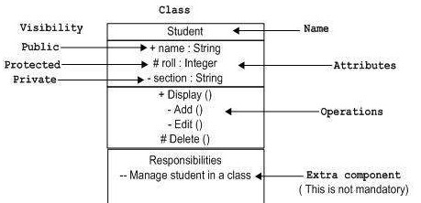
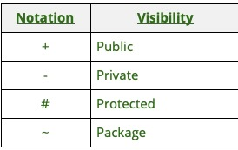
IMPORTANT LABELLING
IN
CLASS DIAGRAM

Slide 5
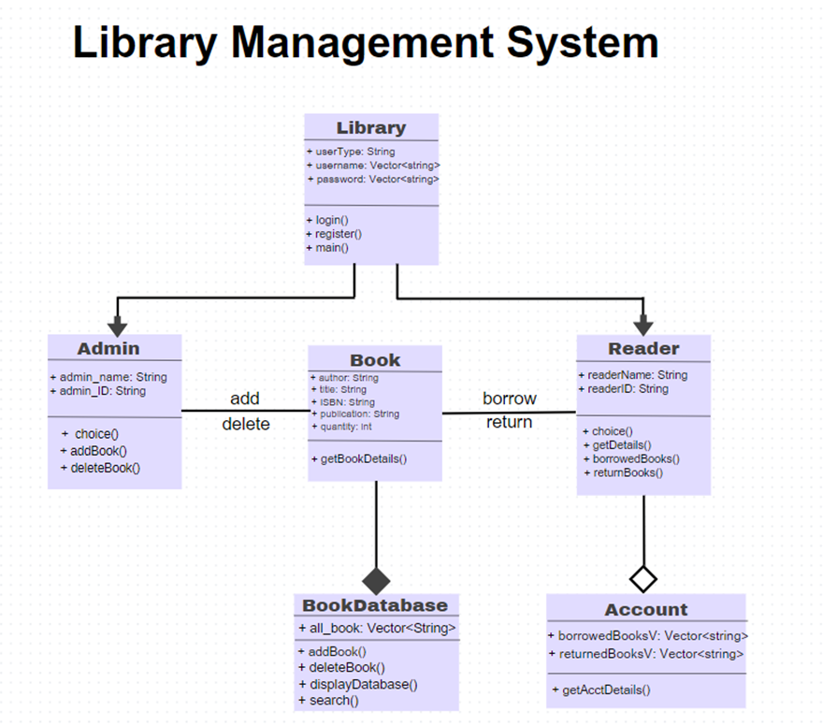
CLASS DIAGRAM

Slide 6
Algorithm:
1. Start
2. The user is given a menu to :
a. Login: If an existing user if valid, the user needs to enter credentials. If the credentials are invalid step 2 is repeated, else control moves to step 3 or 4 depending on whether user is admin or reader respectively.
b. Register: If a new user wants to register, they need to enter credentials and they are stored. Control moves to step 2 again.
c. Exit: program is terminated, control is passed to step 5
3. The admin is provided with a menu:
a. Add book to database: the admin is allowed to add details of a book to the book database
b. Delete book from database: the admin is allowed to delete a book from the book database
c. Display database: the entire book database is displayed
d. Logout: the control moves to step 2
e. Exit: the program is terminated, control is passed to step 5
4. The reader is provided with a menu
a. Borrow book: the reader borrows a book if available
b. Return book: the book the reader if had issued is returned to the database
c. Get Account details: the details of the reader is displayed d. Logout: the control moves to step 2
e. Exit: the program is terminated, control is passed to step 5
5. End

Slide 7
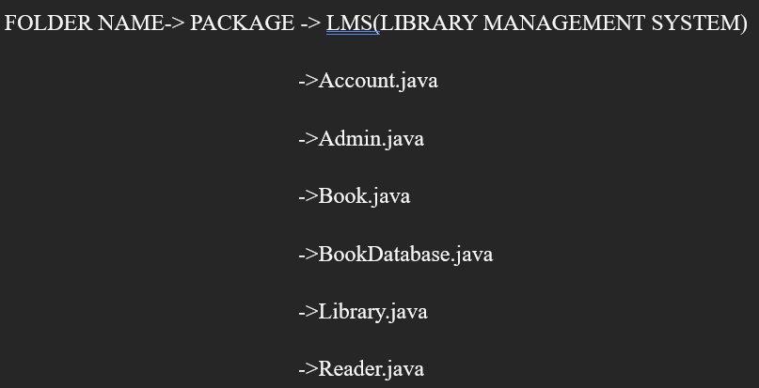
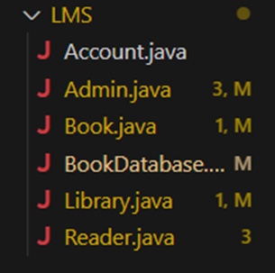
Implementation details:

Slide 8
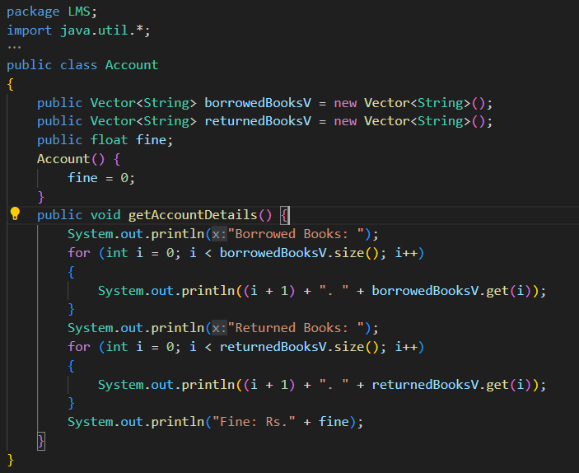
Account.java

Slide 9
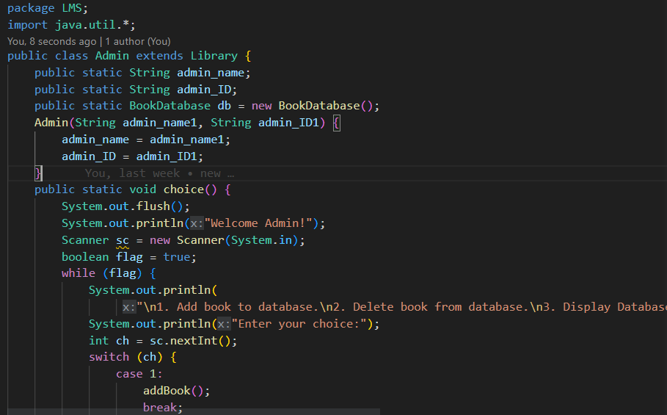
Admin.java
"\n1. Add book to database.\n2. Delete book from database.\n3. Display Database\n4. Logout\n5. Exit");

Slide 10
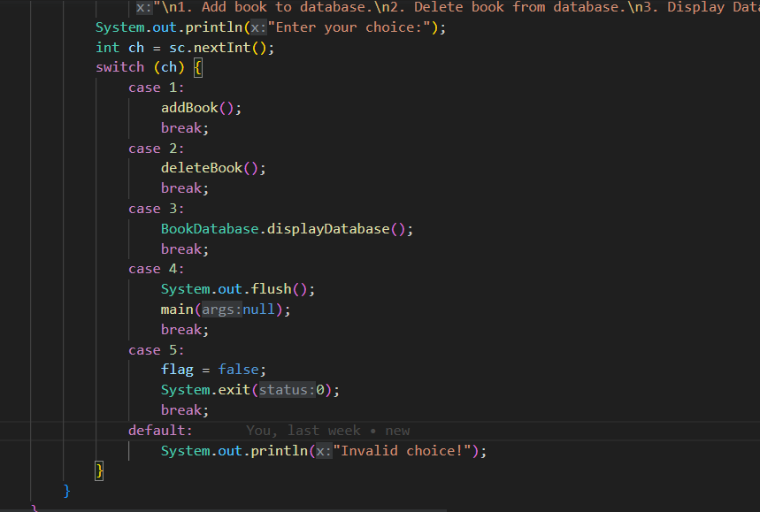

Slide 11
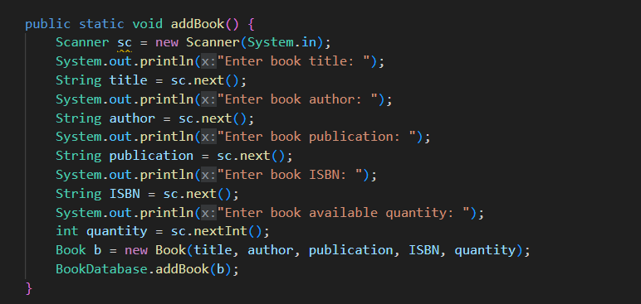

Slide 12
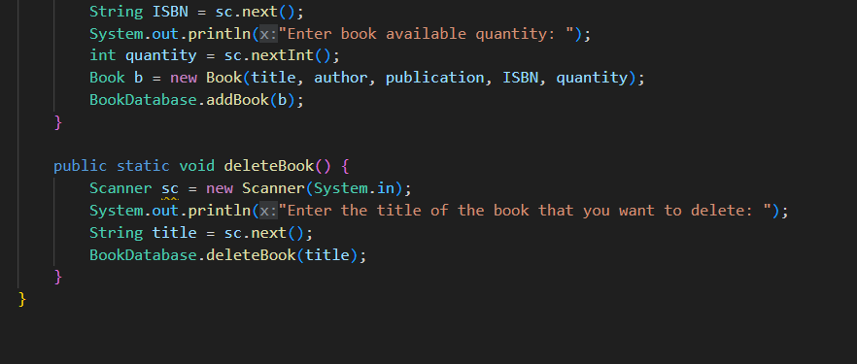

Slide 13
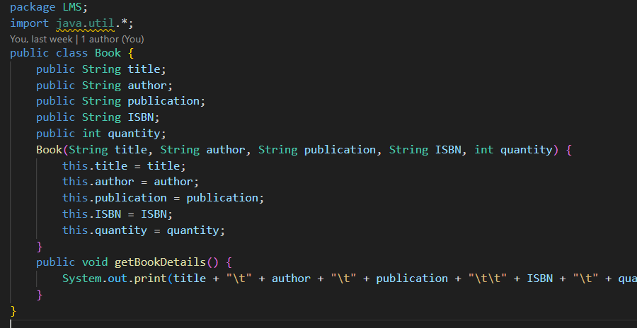
Book.java
title + "\t" + author + "\t" + publication + "\t\t" + ISBN + "\t" + quantity + "\t");

Slide 14
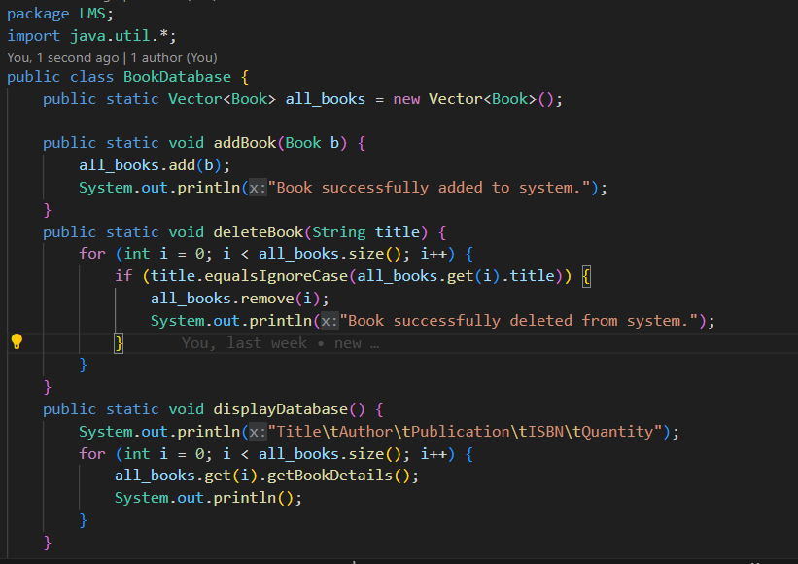
BookDatabase.java

Slide 15
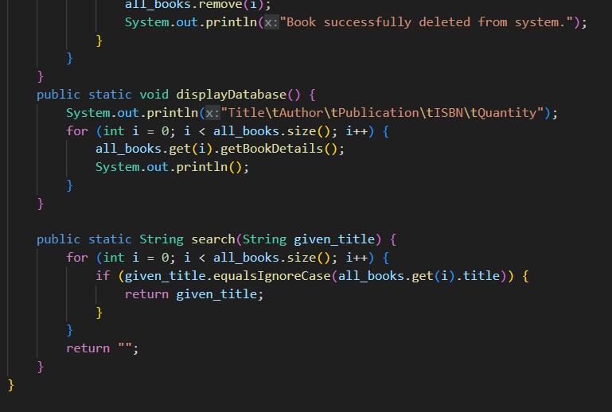

Slide 16
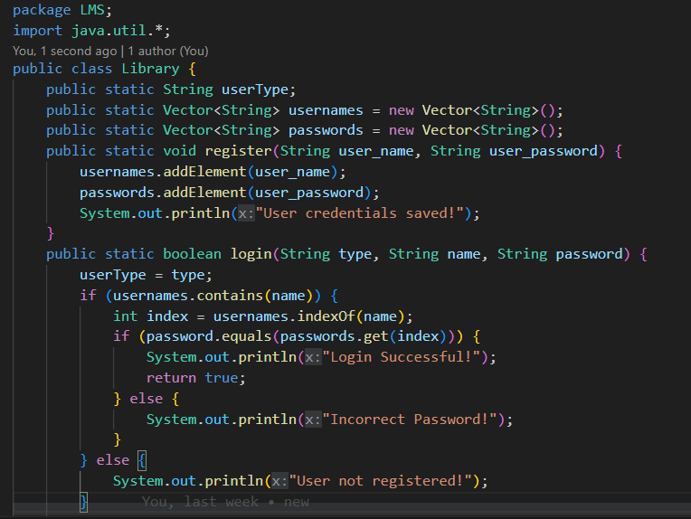
Library.java

Slide 17
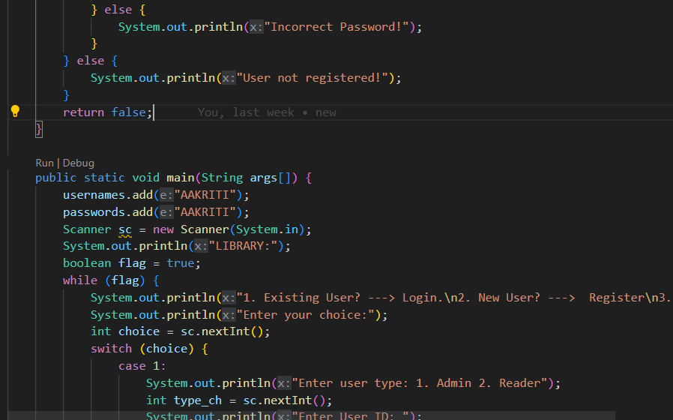

Slide 18
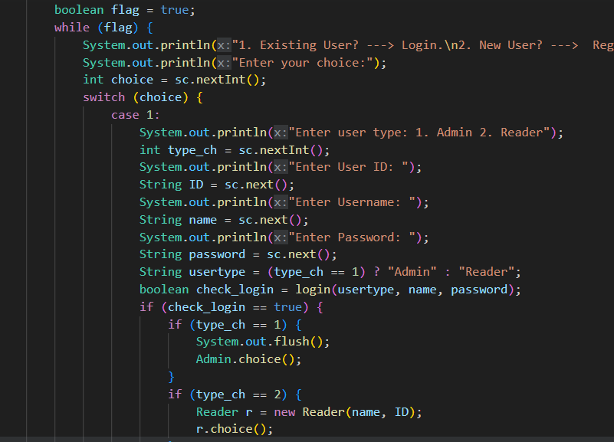

Slide 19
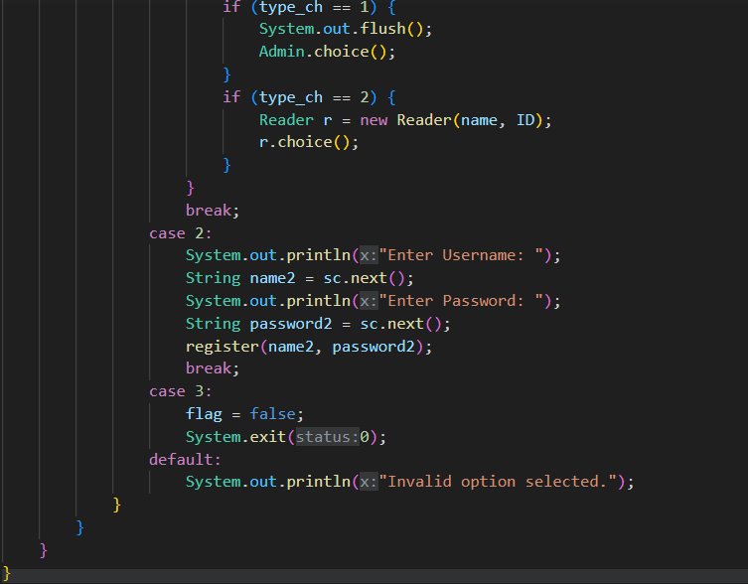

Slide 20
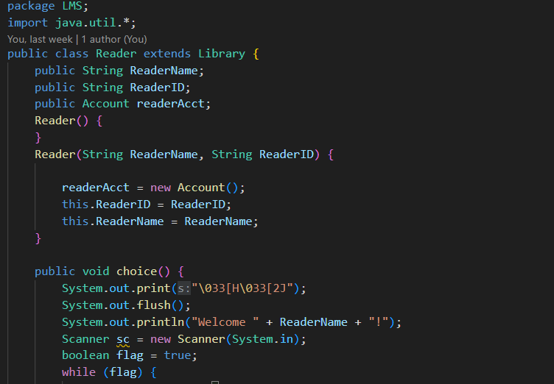
Reader.java

Slide 21
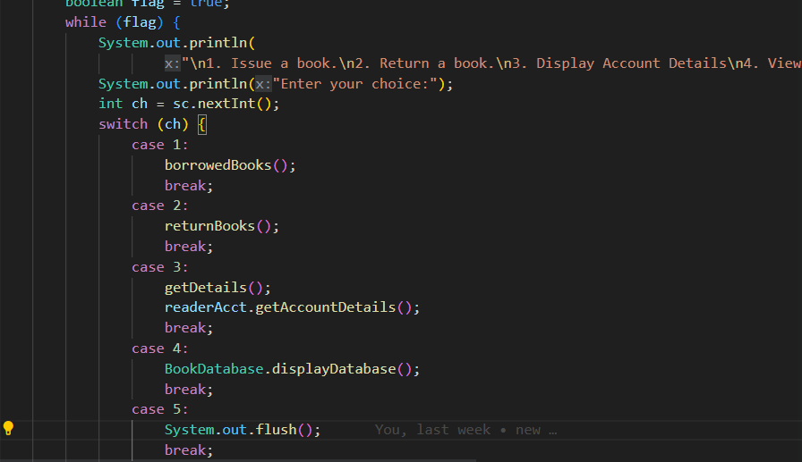

Slide 22
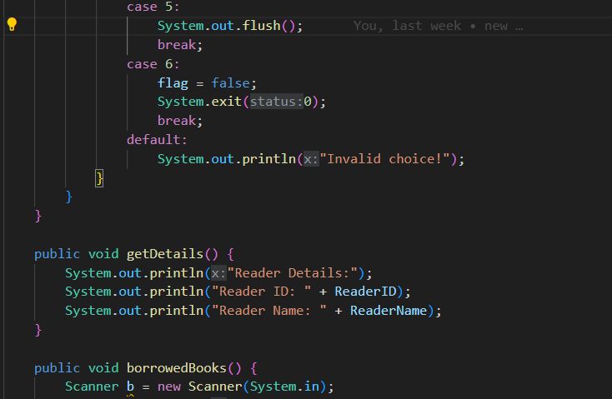

Slide 23
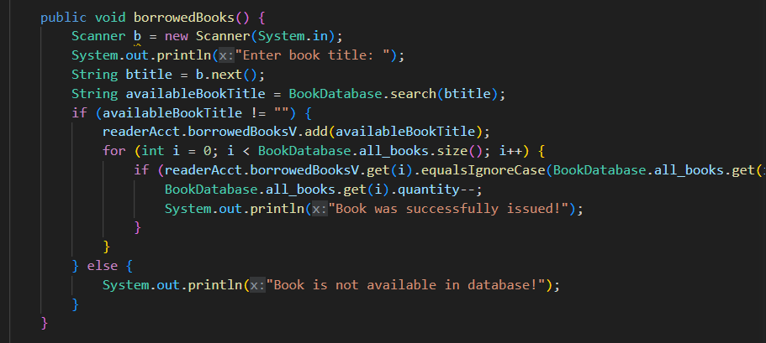

Slide 24
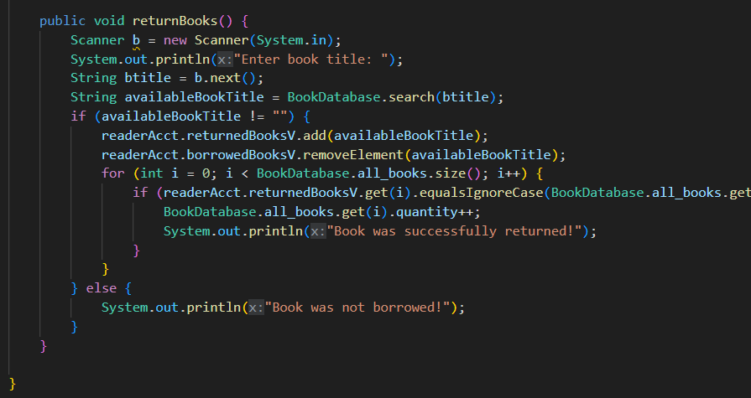

Slide 25
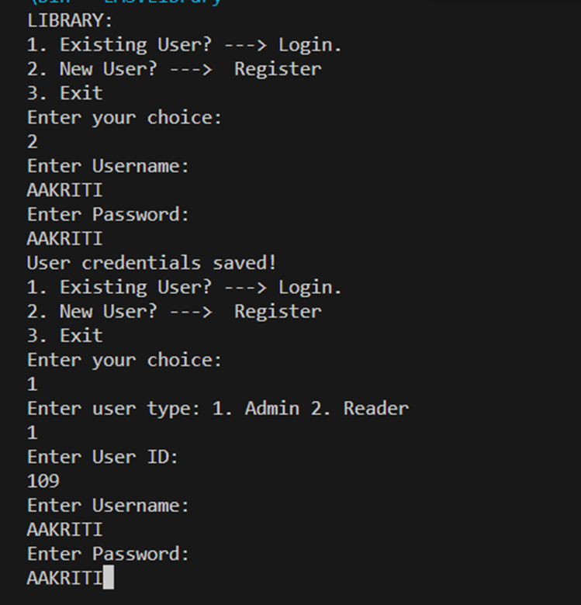
OUTPUT:

Slide 26
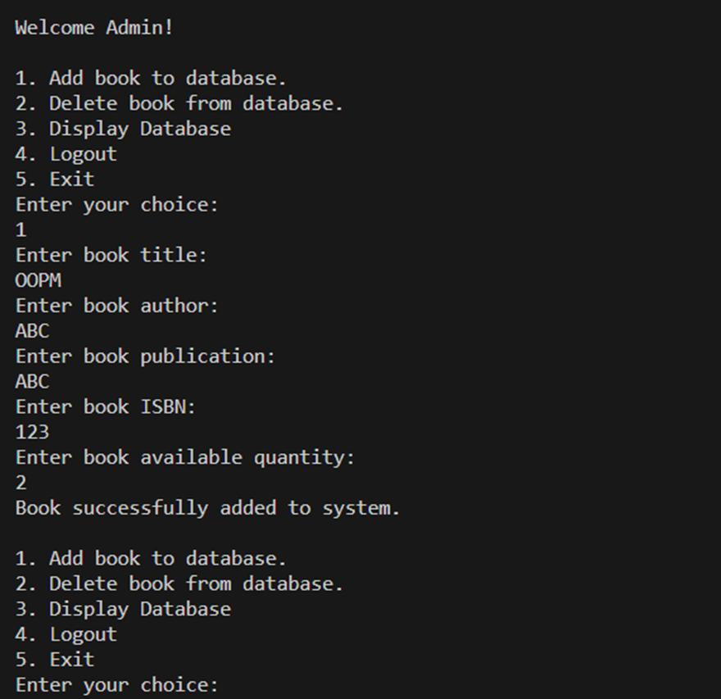

Slide 27
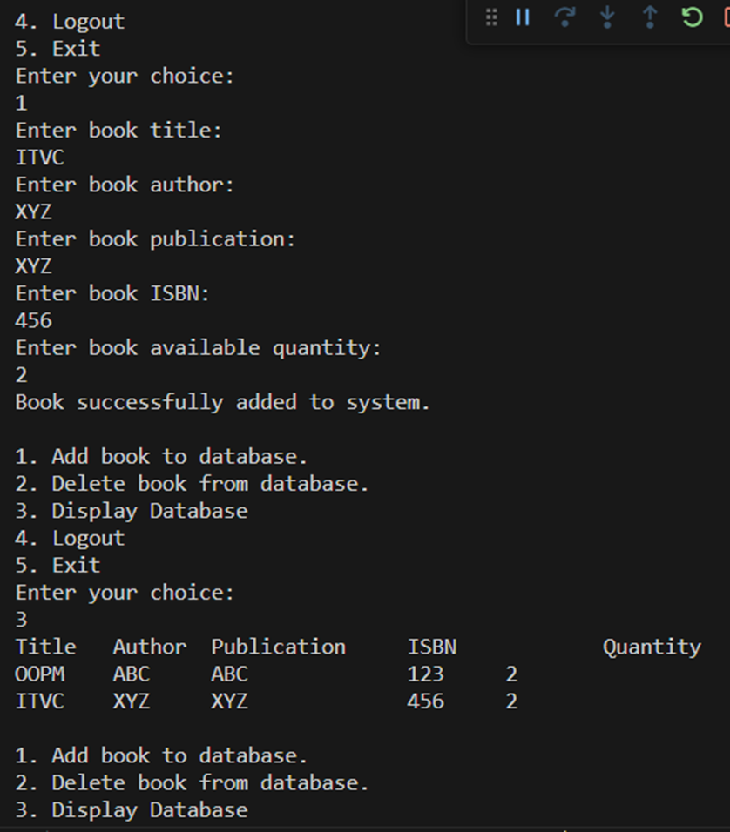

Slide 28
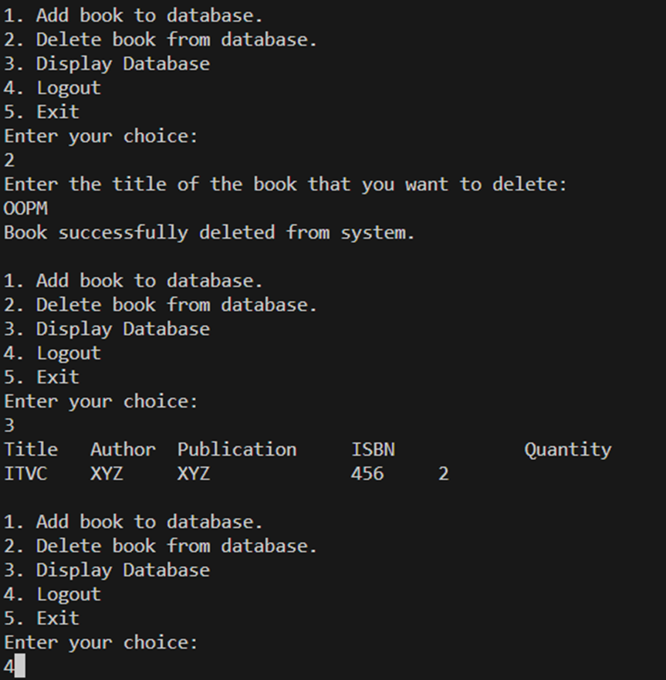

Slide 29
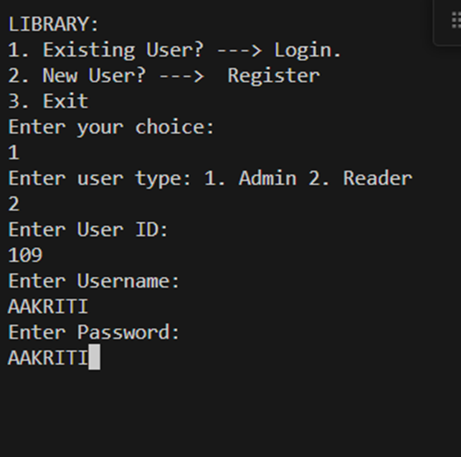

Slide 30
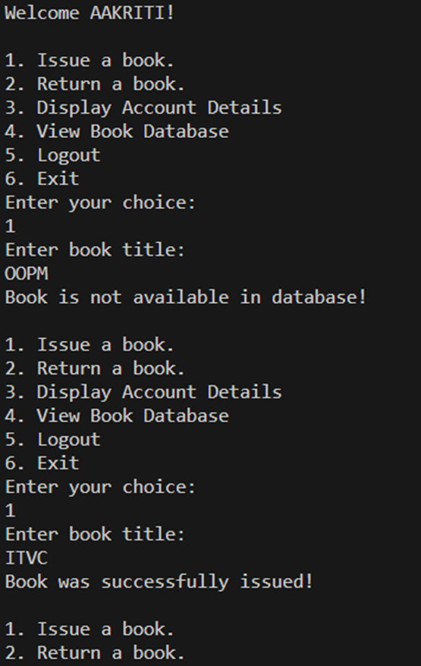

Slide 31
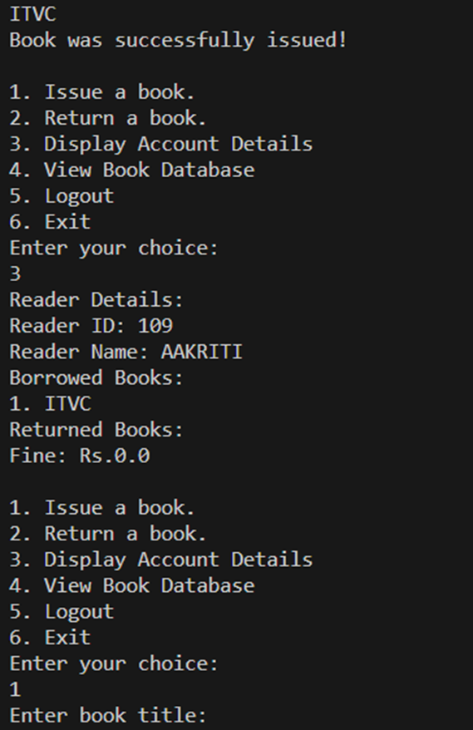

Slide 32
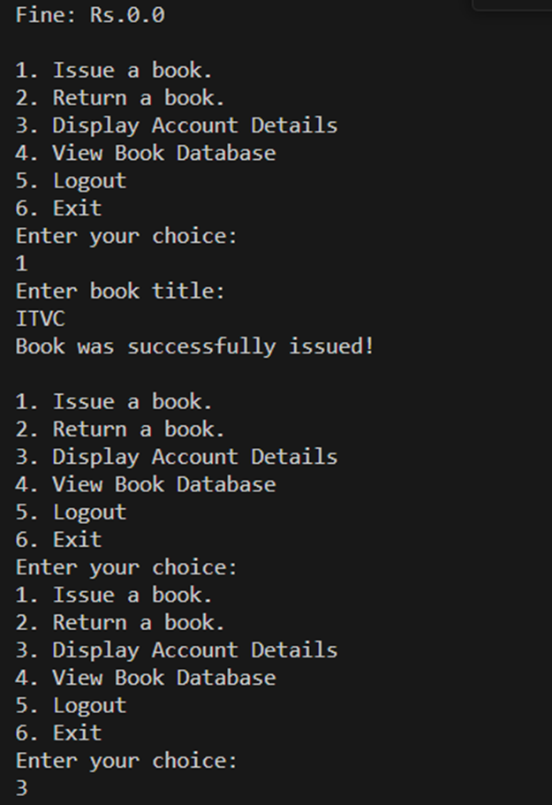

Slide 33
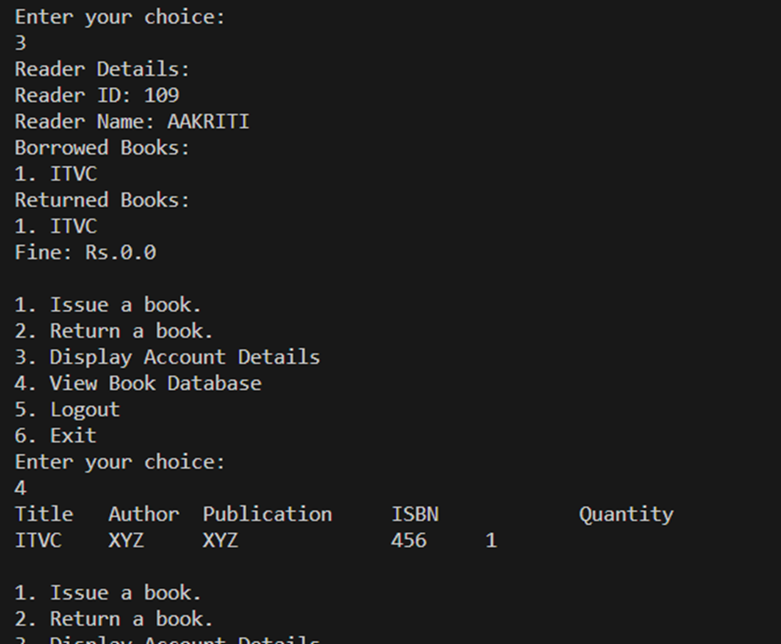

Slide 34
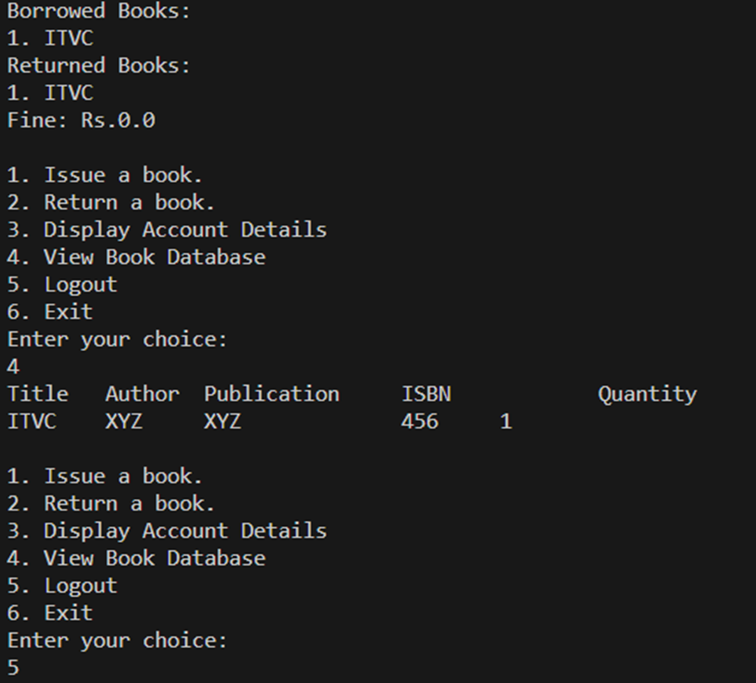

Slide 35
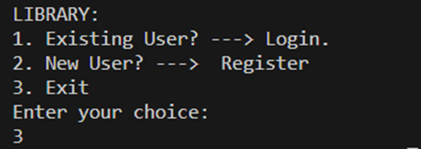

Slide 36
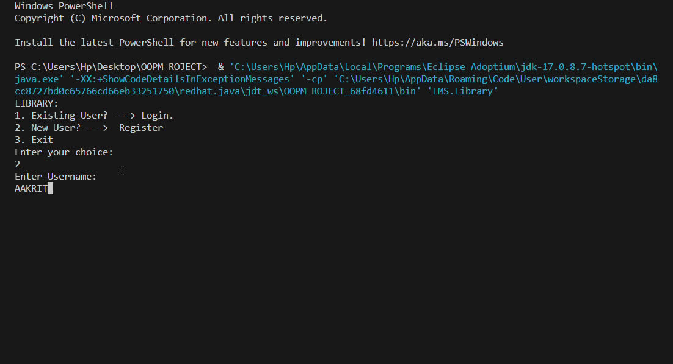

Slide 37


